Slide 1
Secure File Storage On Cloud Using Hybrid Cryptography
Group Number : 24
Group Members : Shruti Kanatt (101622)
Prachi Talwar (101676)
Amey Jadhav (101665)

Slide 2
ROADMAP
Introduction
Problem Statement
Literature Survey
Proposed System
Design
Algorithms Used
Conclusion

Slide 3
INTRODUCTION
Cloud storage: cloud computing model in which data is stored on remote servers accessed from the internet, or ”cloud.”
Advantages:
no hardware to purchase or storage to provision
focus on solving complex application problems instead of on how to manage storage systems
improved security

Slide 4
PROBLEM STATEMENT
Aim: To build a new hybrid algorithm to encrypt files that are to be stored on the cloud storage.
What is the project about ?
In a day and age where cloud computing and storage has become so integral with so many important applications, it is very important to increase the security aspect of it.

Slide 5
PROBLEM STATEMENT
Why are we doing this project ?
Existing system uses algorithms which can compromise on level of security. We aim to solve this problem with our hybrid algorithm.

Slide 6
LITERATURE SURVEY
Securing only text files on cloud using RC6 algorithm
-Paper by Dr. Salim Ali and Amal AbdulBaqi
Achieving security on cloud using layered approach
-Paper by Diao Zhe and Wang Qinhong
Securing data storage using symmetric key algorithm AES
-Paper by Vishal Pancholi and Dr.Bhadresh Patil
Use of DIP for data storage and retrieval with help of PRE
-Paper by Bharat Rawal and Sree Vivek

Slide 7
LITERATURE SURVEY
Securing data storage on cloud through digital signature using RSA
-Paper by K.Govinda and H.Satishkumar
Securing file storage on cloud using ECC algorithm
-Paper by Arjun Kumar

Slide 8
PROPOSED SYSTEM
Build a portal for users to log onto, where they can upload, download and share multimedia files amongst themselves. In the existing system, encryption and decryption is done using RSA and AES algorithms while our hybrid approach uses AES and Blowfish algorithms.

Slide 9
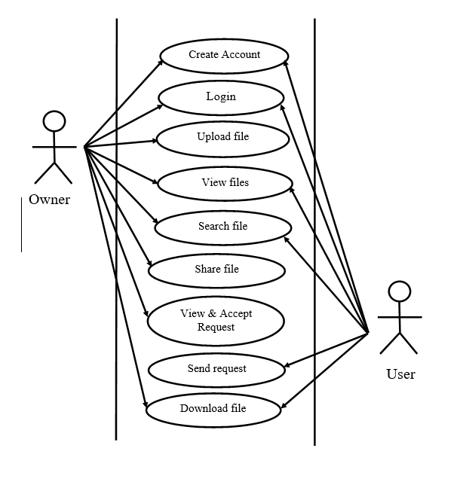
DESIGN:
Use Case Diagram

Slide 10
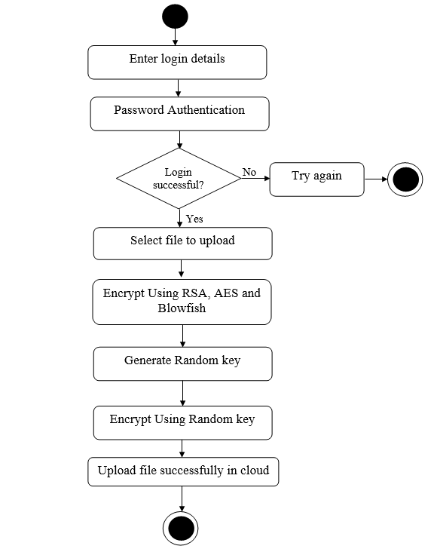
DESIGN:
Activity diagram for Upload

Slide 11
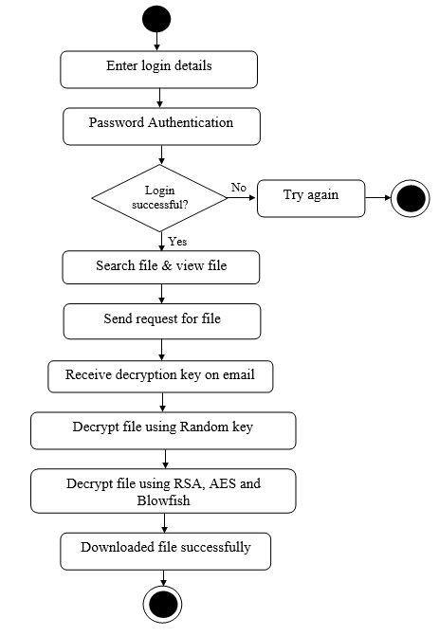
DESIGN:
Activity diagram for Download

Slide 12
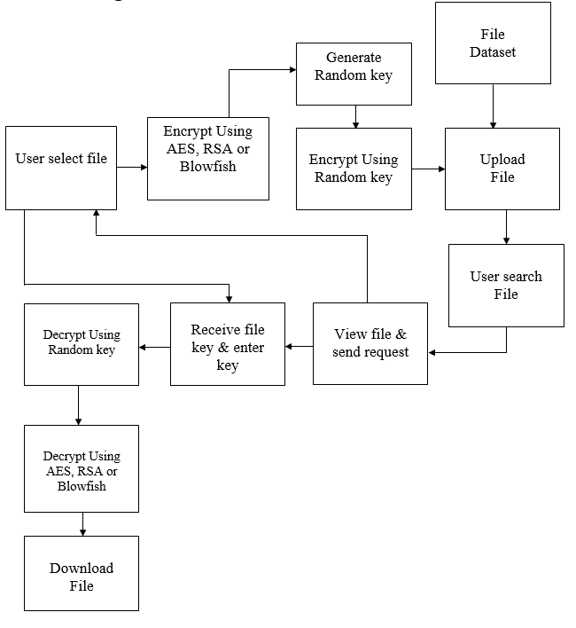
DESIGN:
Block Diagram

Slide 13
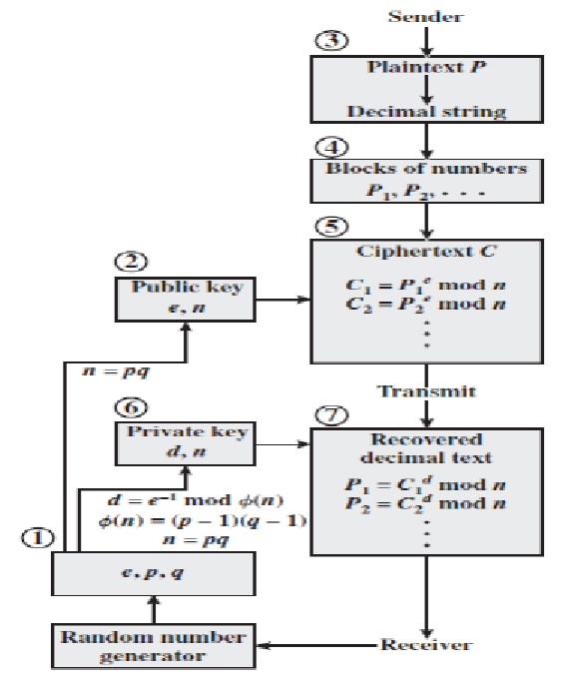
ALGORITHMS
USED
RSA

Slide 14
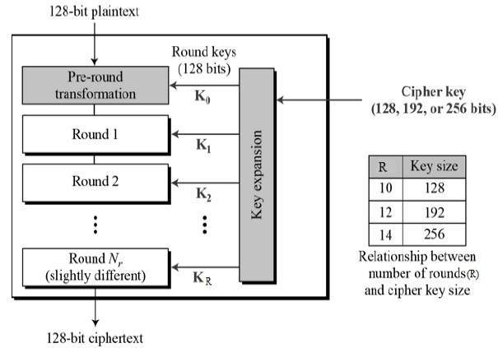
ALGORITHMS
USED
2. AES

Slide 15
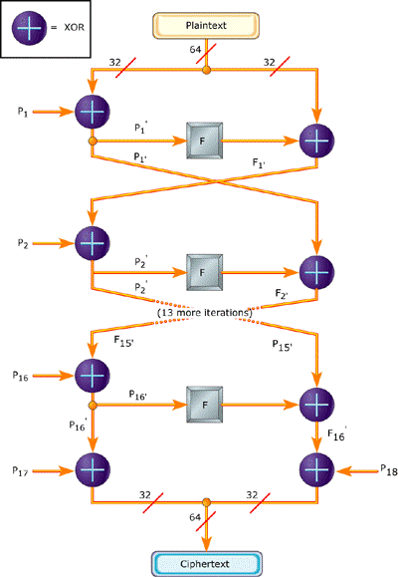
ALGORITHMS
USED
3. Blowfish

Slide 16
SYSTEM REQUIREMENTS
• Hardware Requirements:
1. RAM: 512 MB or more
2. Hard disk: 16 GB or more
3. Internet connection

Slide 17
• Software Requirements:
1. JAVA JDK 7
2. Apache tomcat Server
3. Eclipse
4. Windows Operating System
5. MySQL

Slide 18
ADDITIONAL FEATURES:
Duplication detection
Sharing of files between different portal users

Slide 19
CONCLUSION
What we learnt:
Understanding of different cloud systems
Understanding of different security algorithms
Developing website with cloud access using API
Encryption and decryption of data in file
Overall proficiency in Java

Slide 20
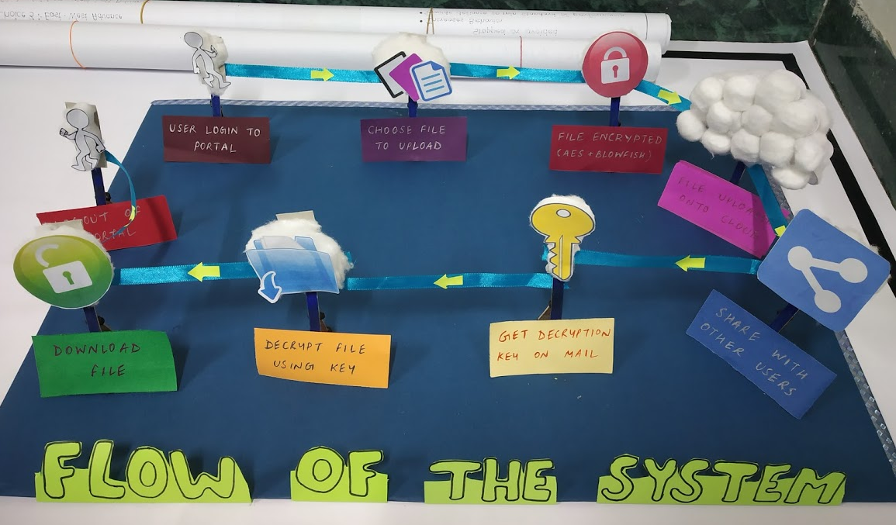
MODEL:

Slide 21
DEMO:

